Slide 1



15.05.2025
2024-2025 Spring Term SE 216 Software Project Management
PetPal
Group 6
Damla İNCEBIYIK - 20230601042
William Ersan ALLAMAND - 20230601008
Mustafa Eren ŞAHİN - 20230601066
Ece KABASAKAL - 20230601043
Cavit KAYA - 20220601045
Birce Erdogan - 20220601027
Burcu DUMANLI - 20230601025
Kaan DÖNMEZ - 20210601202

Slide 2
SMART CAMPUS ANIMAL MONITORING SYSTEM
PetPal is a smart system that helps track and care for stray animals on campus using QR codes, sensor-based feeders, and live updates. It aims to improve animal welfare and create a more organized, safe, and responsible environment for both animals and people.
PetPal

Slide 3
HIGH LEVEL FUNCTIONALITY
What is High-Level Functionality?
It describes what the system is expected to do from a broad perspective.
It focuses on major system behaviours and key features without going into detailed implementation.
It's used in early stages of design to align stakeholders on the overall capabilities of the system.
PetPal

Slide 4
Functional Requirements
The system should allow pet food brands, restaurants, and animal lovers to make food and money donations.
The system must analyze animal movement patterns and detect signs of illness at an early stage.
Administrators should be able to review, then accept or deny adoption requests.
Administrators should be able to create and update animal profiles with name, photo, and health status.
The system must allow users to make adoption requests from animal profiles.
PetPal

Slide 5
Functional Requirements (Continued)
The system must allow veterinarians to mark an animal as healed after responding to reports.
The application should be able to list every animal detected by the nearest RFID detector to the user at the push of the panic button.
Users should be able to report injured or sick animals through the app.
The system should monitor the fill levels of smart food and water bowls in real time and should send notifications and update the map when levels are low.
The system should be able to detect the locations of animals in real time and update a heatmap within the app accordingly.
PetPal

Slide 6
Non-Functional Requirements
The system must support at least 500,000 concurrent users.
System updates must be applied without causing any interruptions.
The system should be able to run on the specified hardware (servers).
The system should update animal locations every 10 seconds.
The system must be accessible 24/7.
PetPal

Slide 7
Non-Functional Requirements (Continued)
The mobile app should have a user-friendly interface.
The app should support Android and IOS as well as web browsers.
The system must comply with any relevant laws.
User data must be encrypted to protect sensitive information.
The app should be optimized to support older or weaker devices.
PetPal

Slide 8
EXTERNAL STAKEHOLDERS
They can report sick and injured animals, check vaccination status, and submit adoption requests, contributing to animal wellbeing.
Students and Campus Community
Animal Welfare Organizations
PetPal helps them to coordinate vaccinations, streamline adoptions, and mobilise volunteers more efficiently.
By donating food, they help reduce operational costs for the project while promoting their products to an engaged audience.
Pet Food Brands
In the event of an animal attack, knowing the types of
vaccinations an animal has, and even its medical history will help narrow down the infections health workers need to treat for.
Health Workers And
Animal Attack Victims
PetPal

Slide 9
Stray animals stand to gain food, water, and potentially homes from the PetPal project, and thus are affected by the outcomes of the project.
Stray Animals
Cafes, Restaurants,
and Butchers
These businesses can save time by having volunteers to pick up leftovers that would otherwise go to waste and use them to feed stray animals and they benefit from a more efficient and cost-effective option.
City councils can save time and resources with PetPal, as stray animal issues and disturbances will decrease, reducing the need for council intervention.
City Councils
Smart device manufacturers are key stakeholders affected by the performance and longevity of the devices they provide—such as RFID sensors, QR code tags, and feeding stations.
Smart Device Manufacturers
PetPal

Slide 10
Campus administration is affected through their involvement
in enabling the project’s infrastructure, granting permissions,
and potentially allocating budget.
Campus Administration
Animal rights clubs benefit from the PetPal system by having a centralised platform to help advocate for animal welfare, run awareness campaigns, and report sickly animals.
Animal Rights Clubs
Potential adopters, including residents in and around the
university area, are directly impacted by the PetPal project
through greater access to adoption opportunities.
Potential Adopters
Vets
Veterinarians benefit from having easier access to animal
health and vaccination records via the platform.
PetPal

Slide 11
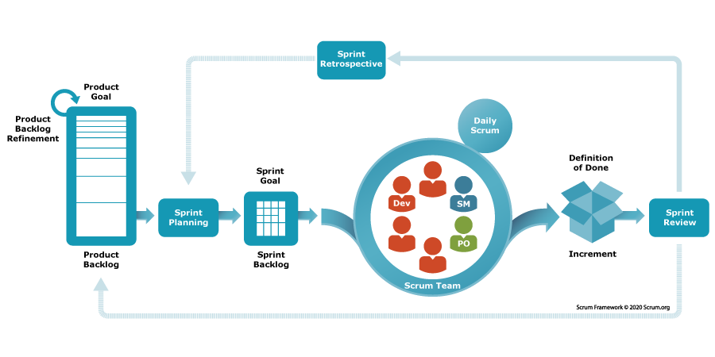
SOFTWARE PROCESS MODEL
SCRUM:
Scrum is an agile project management framework emphasizing flexibility, teamwork, and iterative progress. It involves three key roles: the Product Owner, who prioritizes work and manages the backlog; the Scrum Master, who ensures the team adheres to Scrum practices and facilitates problem resolution; and the Development Team, which delivers increments of the product. Scrum employs artifacts like the Product Backlog and Sprint Backlog to track work and uses events such as Sprint Planning, Daily Scrum, Sprint Review, and Sprint Retrospective to facilitate communication and continuous improvement. The primary goal of Scrum is to deliver value to customers efficiently while promoting transparency and continuous development.
PetPal

Slide 12
SPRINT 1:
SPRINT 2:
● Starting Development of the Mobile App
● Development of Animal Profiles for the Mobile App
● Adding Adoption and Report Illness Menus to Animal Profiles
● Implementing the Heatmap UI Within the Mobile App
● Implementing the Panic Button
● Implementing Notifications
● Implementing the Offline Mode for the Mobile App
● Legacy Support
● Database Planning
● UI / UX Planning & Preparation of UI Templates for Design Purposes
● Layout Planning for RFID Sensor Locations
● Outlining any laws the system must comply with
● Layout Planning for Smart Feeding Stations
PetPal

Slide 13
SPRINT 3:
SPRINT4 :
● Database Integration
● Animal Profile Storage
● Location Tracking
● Adoption Requests and Reports
● Admin Dashboard
● Database Backup
● Implement QR Scanning
● Smart Feeding Stations Database Integration
● Testing
● Security Enhancements
● Bug Fixes and UI & UX Enhancements
● Mounting Feeding Stations and RFID Sensors in Planned Locations
● User Guide Preparation
● Launching the System
PetPal

Slide 14
SCHEDULE AND EFFORT
Key Points From the Project Schedule
Divided into 4 main parts
Predecessors were applied to ensure task dependency and order
Timeline: 42 workdays (May-July 2025)
PetPal

Slide 15
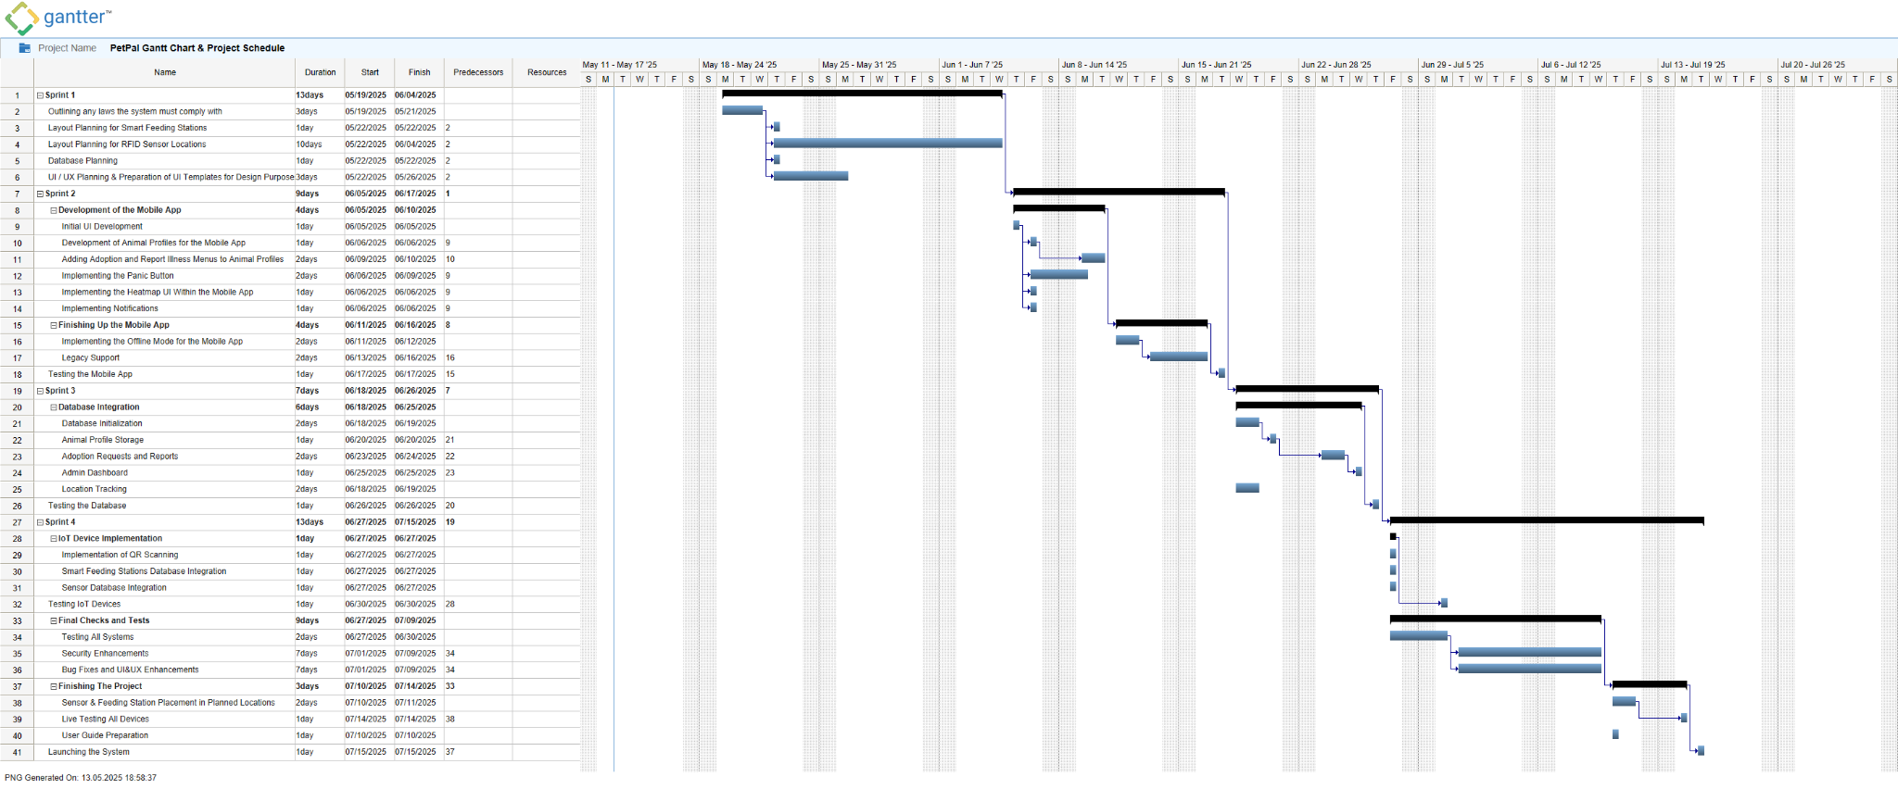
PetPal

Slide 16
PROJECT RISKS
Why Do We Analyze Risks?
To ensure system reliability and animal safety.
To identify technical, ethical, and operational threats.
To prepare proactive solutions before problems arise.
PetPal
Notes:
In every tech-based project, especially one involving live animals and the public, it’s essential to evaluate what could go wrong and plan ahead

Slide 17
HIGH-PRIORITY RISKS
Top Risks Identified
Sensor Theft or Tampering: Disrupts tracking system
Animals Rejecting Collars: Affects monitoring & data accuracy
System Integration Failures: Components may not work together
Device Malfunctions: Smart bowls, collars may stop working
PetPal
Notes:
These are our highest-ranked risks in terms of both likelihood and impact. If not addressed, they can directly affect core system functions.

Slide 18
OTHER SIGNIFICANT RISKS
Additional Concerns
Technical Risks:
Data overload → Lag or crashes
Internet/power outages → Interrupt operations
Cyber attacks → Unlikely, but possible
Ethical Risks:
Animal abuse via app info
Troll users wasting admin time
Panic button confusion in dense areas
PetPal
Notes:
Besides core system risks, we also considered ethical issues and edge cases that might affect user experience or animal well-being.

Slide 19
MITIGATION STRATEGIES
Risk Reduction Measures
Secure sensor placement
Hardware durability testing
Backup systems for power/internet
Admin alerts for abuse & verification
Limit data exposure for animal safety
PetPal
Notes:
Even if we can’t eliminate all risks, these strategies will help us reduce their impact and ensure a more stable and ethical system

Slide 20
SOFTWARE TOOLS
Focusing on
Considering
Development,
Database management,
UI/UX design.
Cost,
Training days,
Functionality.
PetPal
Notes:
In every tech-based project, especially one involving live animals and the public, it’s essential to evaluate what could go wrong and plan ahead

Slide 21
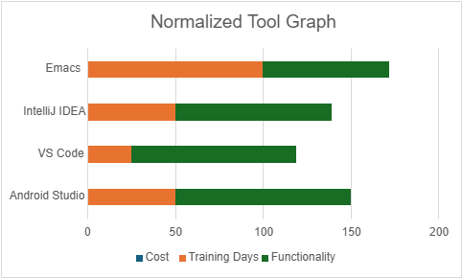
SOFTWARE TOOLS
Development of the Mobile Application
Android Studio:
most stable and comprehensive Flutter development environment
built-in emulators, advanced debugging tools and deep integration with Android SDK
strong community support and detailed documentation
PetPal
Notes:
In every tech-based project, especially one involving live animals and the public, it’s essential to evaluate what could go wrong and plan ahead

Slide 22
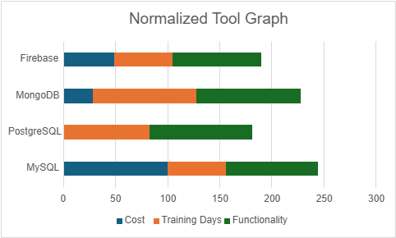
SOFTWARE TOOLS
2. Database Management System
Firebase:
integrates with Flutter using official plugins
fast and reliable implementation of core features
real-time synchronization and easy scalability
PetPal
Notes:
In every tech-based project, especially one involving live animals and the public, it’s essential to evaluate what could go wrong and plan ahead

Slide 23
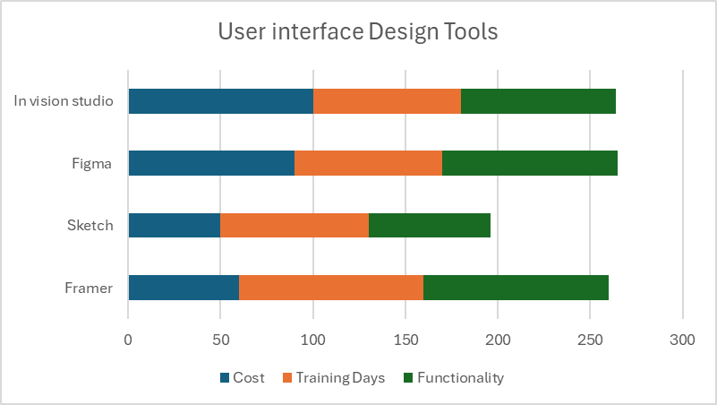
SOFTWARE TOOLS
3. User Interface Design
Figma:
cloud-based accessibility, powerful collaboration tools and interactive prototyping
allows team members to work together seamlessly
plugin ecosystem simplifies tasks, helping us design critical UI components
PetPal
Notes:
In every tech-based project, especially one involving live animals and the public, it’s essential to evaluate what could go wrong and plan ahead

Slide 24
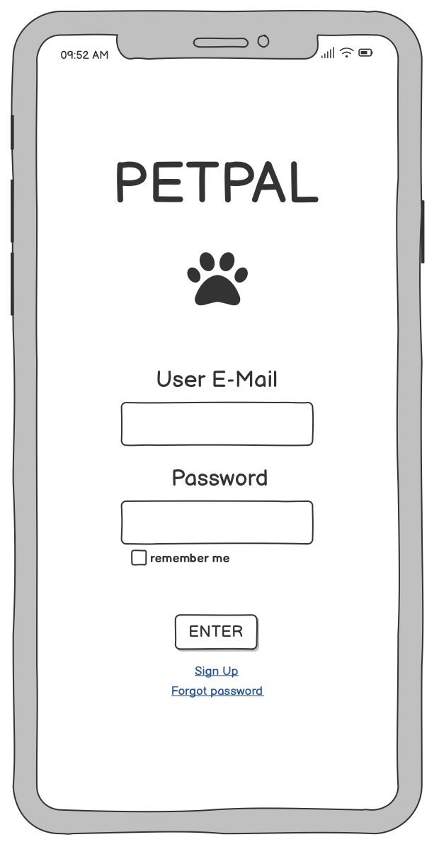
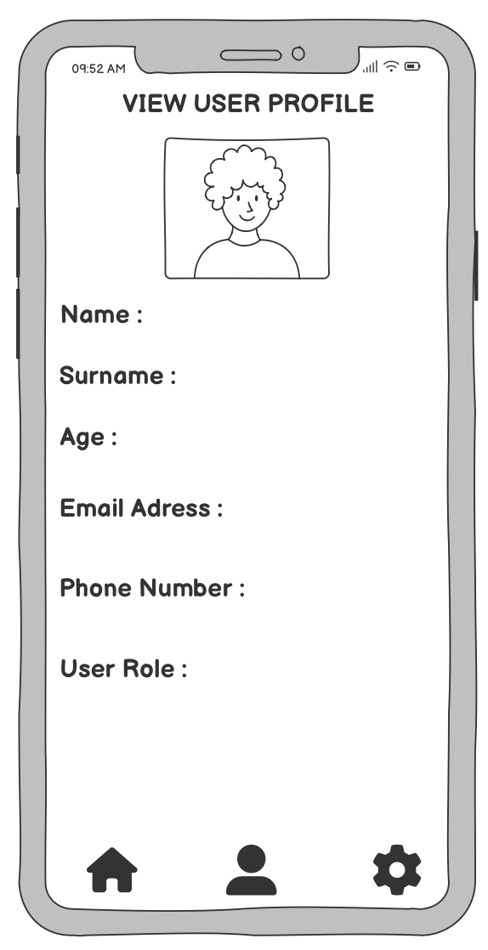
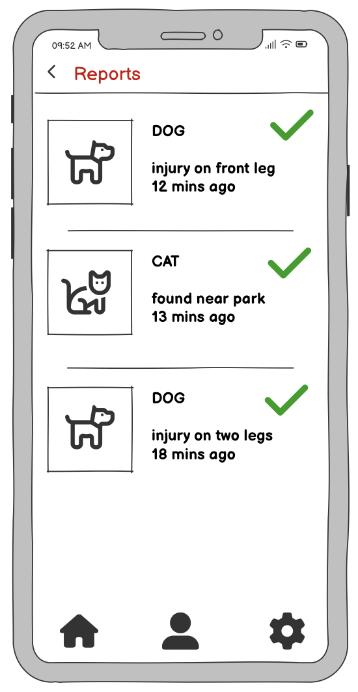
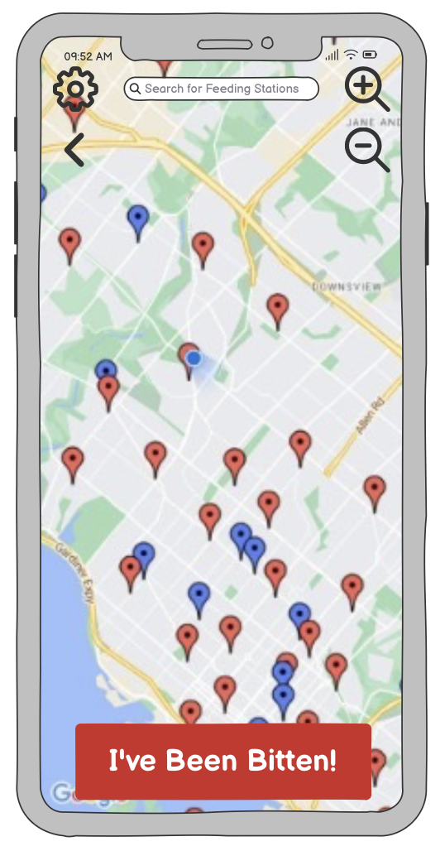
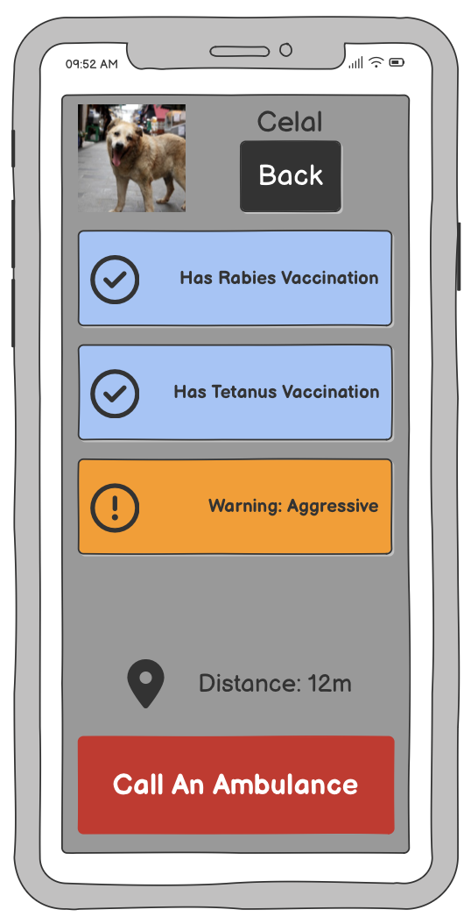
GUI
PetPal

Slide 25
THANK YOU FOR LISTENING!
PetPal

